Slide 1
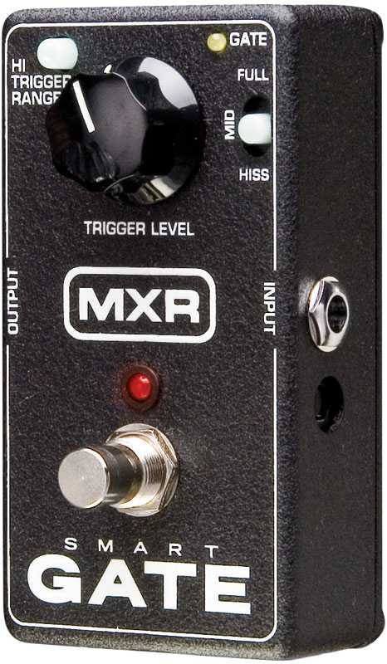
Expansion / Noise Gating

Slide 2
Expanders and noise gates are dynamics processors
Function is opposite of compression
Increase perceived dynamic range of signal
Attenuate low level signals
Leave high level signals unchanged
Expander uses variable gain control
Controlled by level detector
Gain never greater than 1
Gain = 1 for loud signals, < 1 for soft signals
Opposite of compressor
soft signals get softer
Noise gating is expansion taken to extreme
Heavily attenuate or eliminate low-level input
Used to eliminate signals containing only noise
x[n]
X
y[n]
Level
Detector
Gain
Control
(look familiar?)

Slide 3
(a) Audio from snare drum microphone with spill from cymbals and kick drum (b) same recording with noise gate applied to remove low level bleed
(a)
Audio from snare drum microphone with spill from cymbals and kick drum
(b)
same recording with noise gate applied

Slide 4
Expander reduces signal level only when it drops below threshold
Knee = transition between
expanded and
unexpanded
regions
Output
level (dB)
No expansion
2:1 expansion
3:1 expansion
∞:1 expansion
(noise gate)
Ratio = amount that decreasing
input level affects output level
Threshold
Input level (dB)
Threshold = input level at which
expander activates
(above this, gain = 1)

Slide 5
Implementation notes
Level detector calculates signal level over period of time
Not instantaneous sample value
Use RMS or envelope calculations
Example: sine wave is 0 at certain times, but doesn’t mean there’s no signal at these points
Amount of expansion expressed as ratio
Change in input dB → change in output dB
Not the same as gain
x_{dB}=20 log₁₀(x)
Example: 4:1 expansion ratio
3dB input drop produces 12dB output drop

Slide 6
Noise gating
Large ratio = noise gating
10:1 or higher expansion ratio
Line approaches vertical below threshold
Signal may be completely removed
An on/off switch for audio
Most important parameter?
Threshold
Where gate “opens” and “closes”
High signal → gate open
Low signal → gate closed

Slide 7
Attack and release
(not quite) analogous to compressor
Provides ballistics and smoothing
Attack time: time required for expander to respond to increasing signal level (gain reaches 1)
Release time: time required for expander to respond to decreasing signal level (gain drops toward 0)

Slide 8
Effect of an expander
Only middle portion of input is above expander's threshold value
Takes time for expander to increase gain when input rises above threshold
When input drops below threshold, expander slowly reduces gain
Attack
Time
Release
Time

Slide 9
Why use expansion / noise gating?
Increase dynamic range of low-quality recordings
More extremes on cassettes/vinyl which have low dynamic range
Potentially less of an issue in digital systems
What sampling parameter affects dynamic range?
Noise reduction
Reduce feedback, unwanted bleed between tracks
Eliminate noise or hiss in absence of a signal
Set the right threshold
Don’t cut off any of the instrument sound
Don’t let through any ambient noise
Noise still there when instrument is playing. Why isn’t this a problem?

Slide 10
Companding
Compression and expansion are complementary
Reduce effects of noise when transmitting signal
Not just for audio systems
Assume transmission channel has limited dynamic range
Compress before you transmit
Increase average signal level with respect to channel noise
Expand after you receive
Restore signal to its original range (artifacts)
Noise is attenuated
Used in analogue audio recording
e.g. Dolby A noise reduction

Slide 11
Placement in the Effects Chain
Noise gate often near end of effects chain
other effects can produce noise
have noise gate after them so noise not heard & amplified when not playing.
If using delay and reverb effects, place them after noise gate
sound trails off naturally rather than abrupt silence.

